Slide 1
Lab 4a: Schematic Assembly

Slide 2

What You Will Build

Slide 3
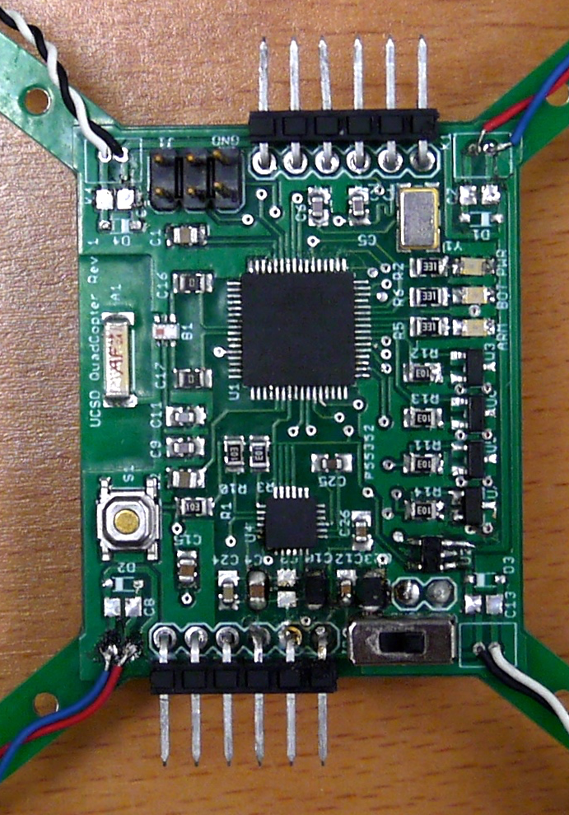
What You Will Build

Slide 4
Three Schematic Design Skills
Copy – You will manually copy the microcontroller circuit from the remote.
Copy – you’ll copy the motor controller based on a schematic I provide.
Implement – You will look at the data sheet for the IMU and voltage regulator and implement the design it provides.
Design – you will add some LEDs to your design on your own.

Slide 5
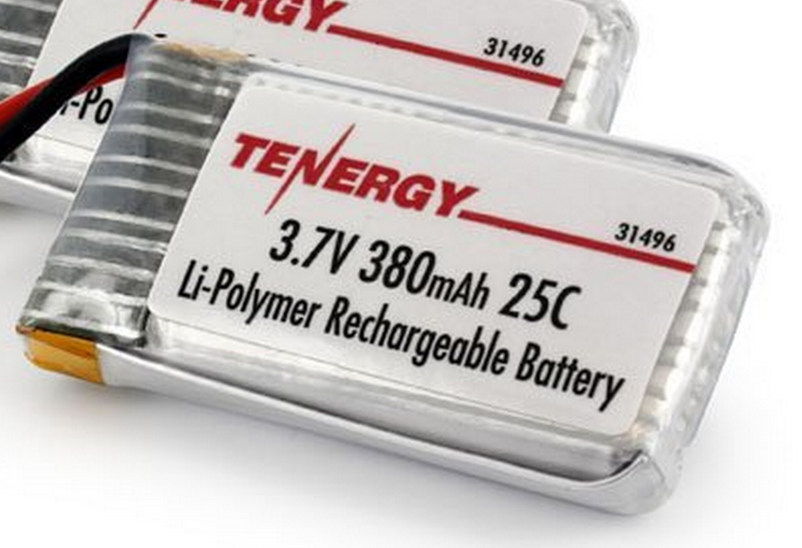
Power Supply
Lithium Polymer Battery
370 Mah
Max 9.25 Amps
Nominal voltage = 3.7V
Powers the motors directly
3.3V low dropout (LDO) voltage regulator
Powers the microcontroller and the IMU

Slide 6
Regulator Datasheet

Slide 7
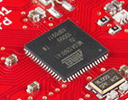
Flight Computer
ATmega128RFA1 microcontroller
Arduino compatible
16Mhz clock
128KB Flash
16KB SRAM
4096B EEPROM
2.4GHz radio (Compatible with Zigbee)

Slide 8
uController Datasheet

Slide 9
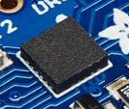
Inertial Measurement Unit
STMicro LSM9DS1
9-axis sensor
3-axis accelerometer
3-axis magnetometer
3-axis gyroscope
We will use the I2C interface

Slide 10
IMU datasheet
Notes
You can tie all the RES/GND pads to one pin on the schematic symbol

Slide 11
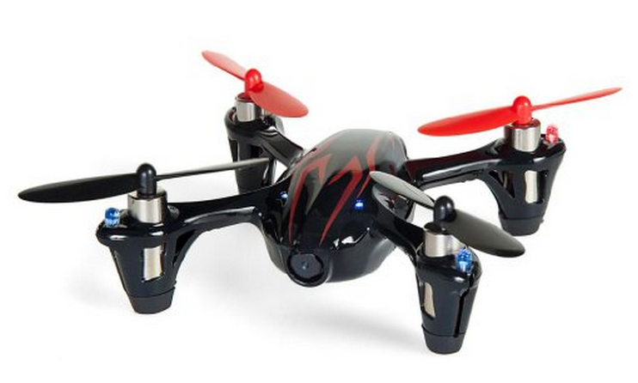
Motors and Props
Plenty of power
DC brushed motors
They draw ~2A each.

Slide 12
Motor Driver
Pulse-width modulation (PWM)-controlled MOSFET
The microcontroller will drive the MOSFET
The MOSFET will drive current to the motor.
A diode handles the inductive load from motor when it’s off.

